Slide 1
AutoML Pipeline in R
Power of Makefiles in automating workflows

Slide 2
Machine Learning Overview
Supervised Learning
Types
Regression (numerical prediction)
Classification (categorical prediction)
Concepts
Training and testing sets
Unsupervised Learning (not part of this session)
Clustering
Dimensionality Reduction

Slide 3
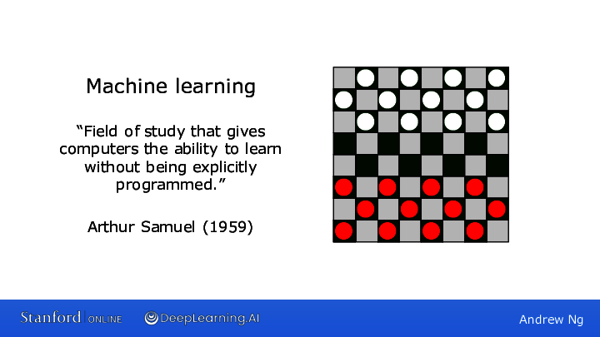
Machine Learning Overview

Slide 4
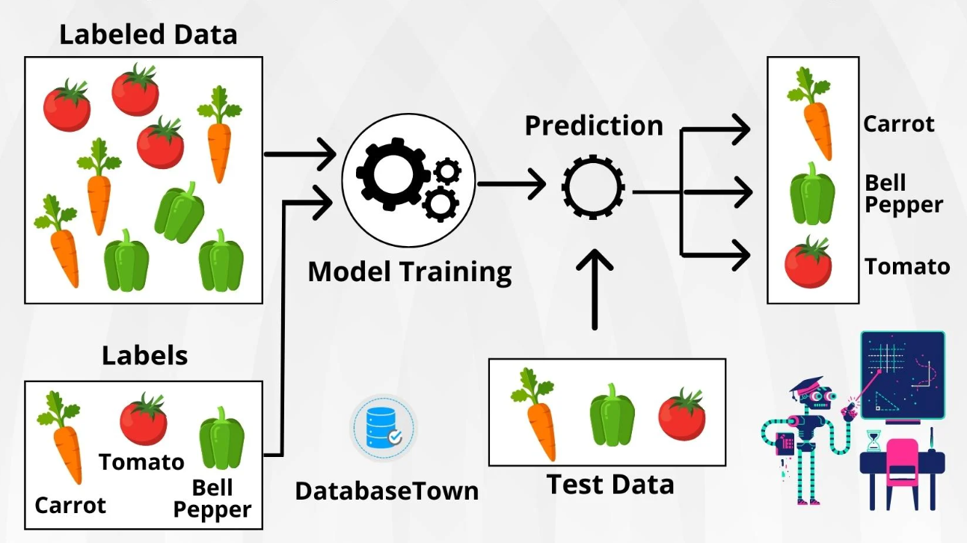
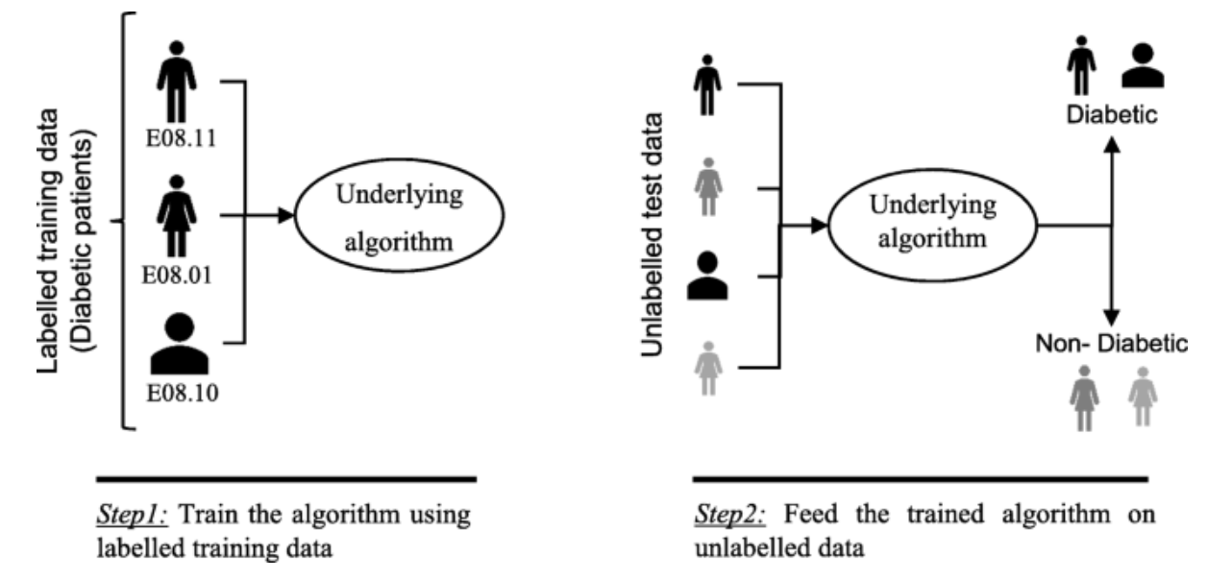
Supervised learning

Slide 5
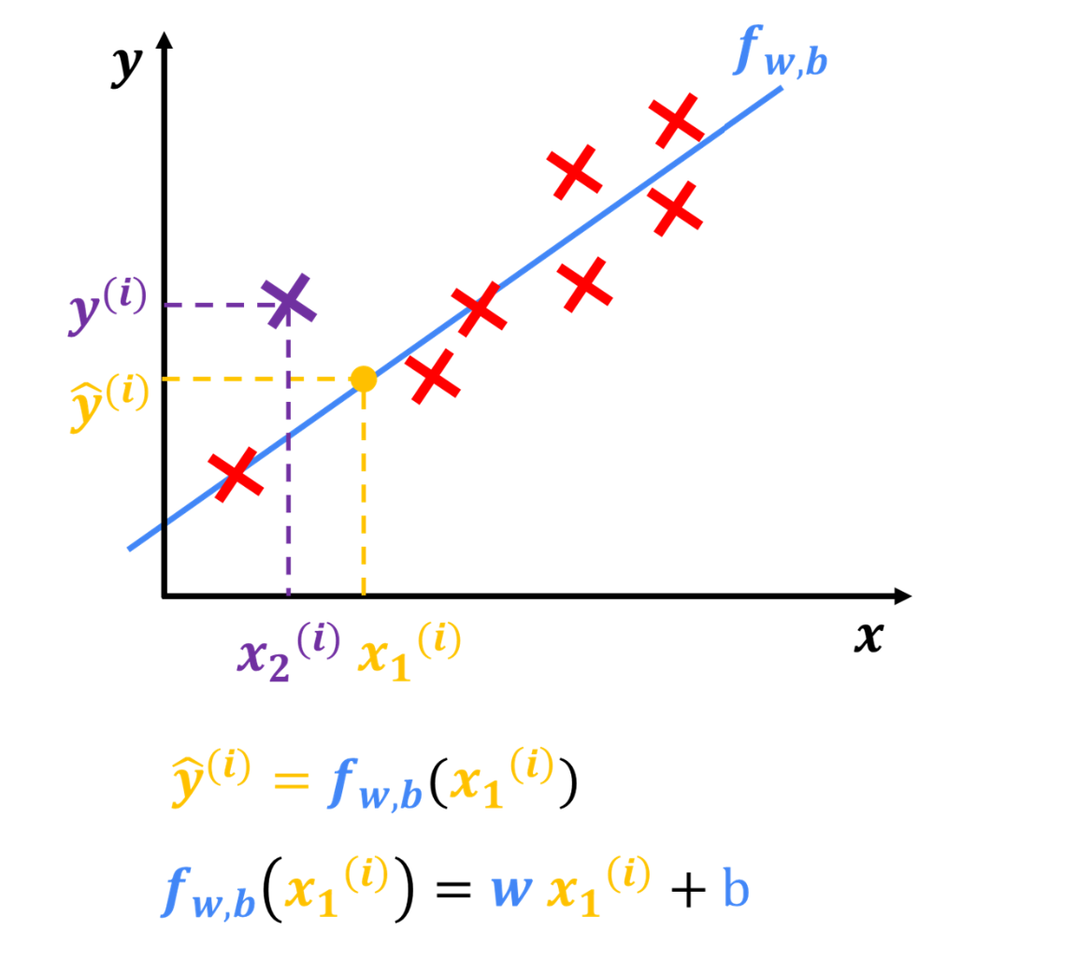
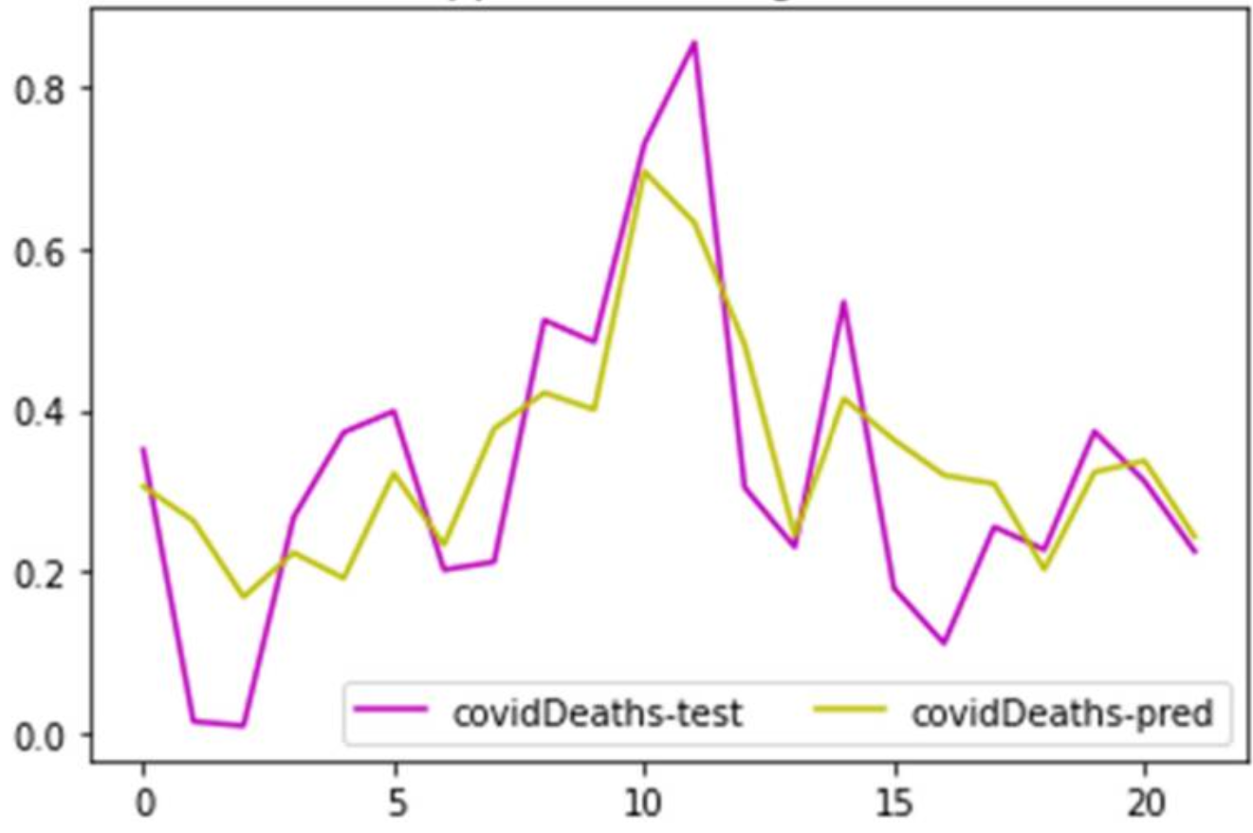
Regression problems

Slide 6
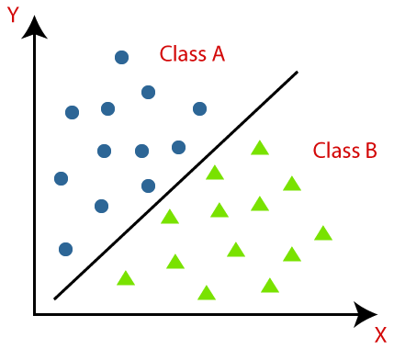
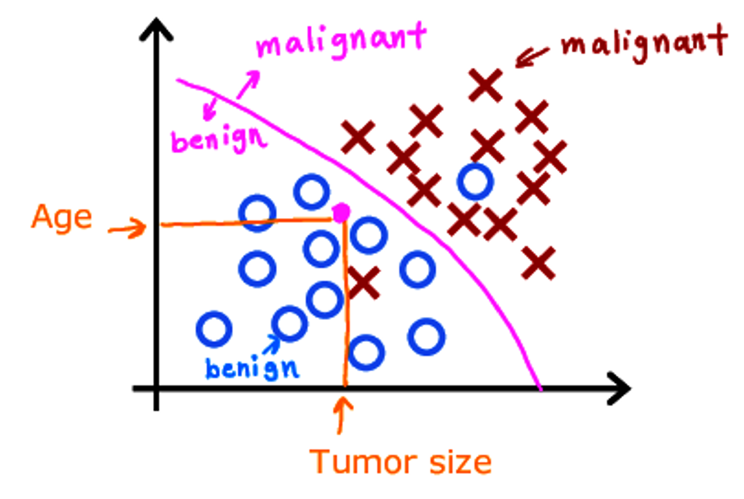
Classification problems

Slide 7
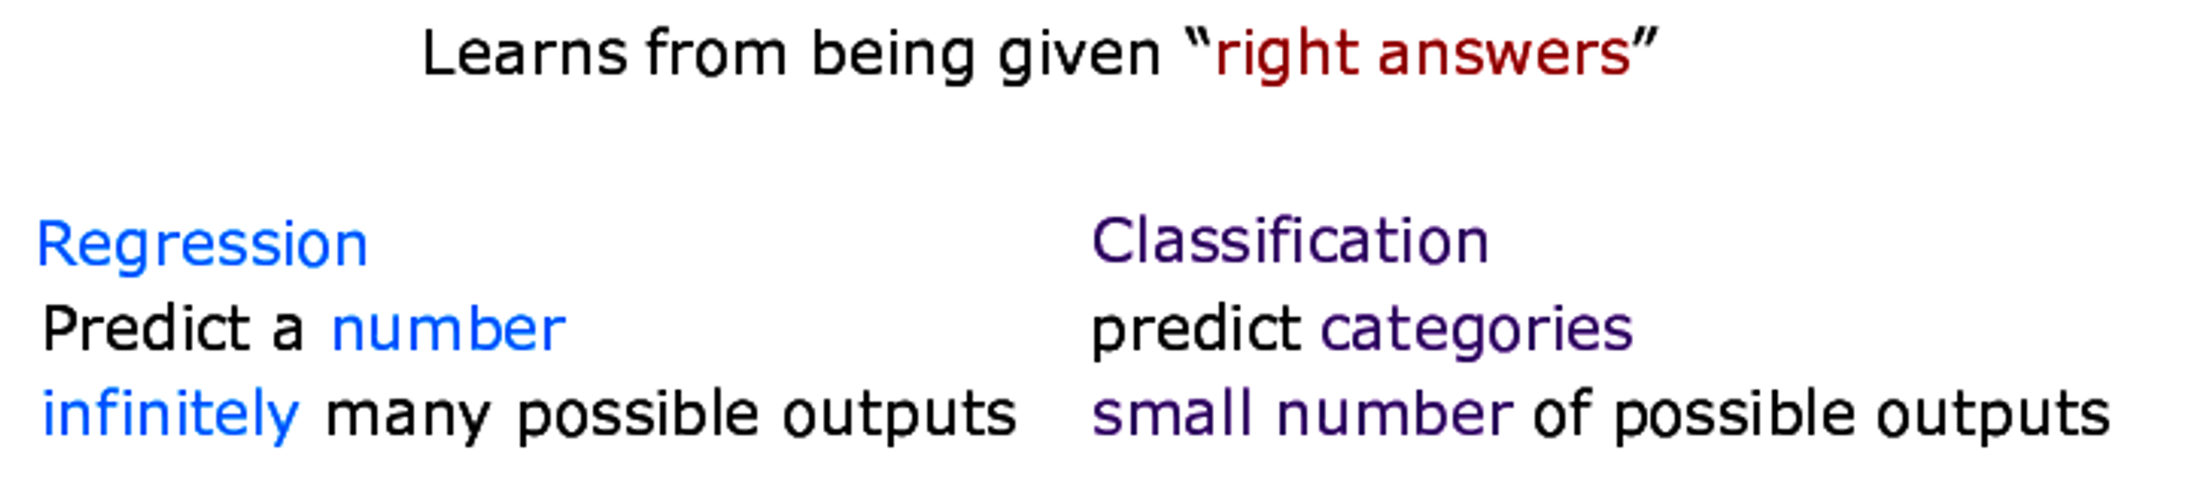
Supervised learning

Slide 8
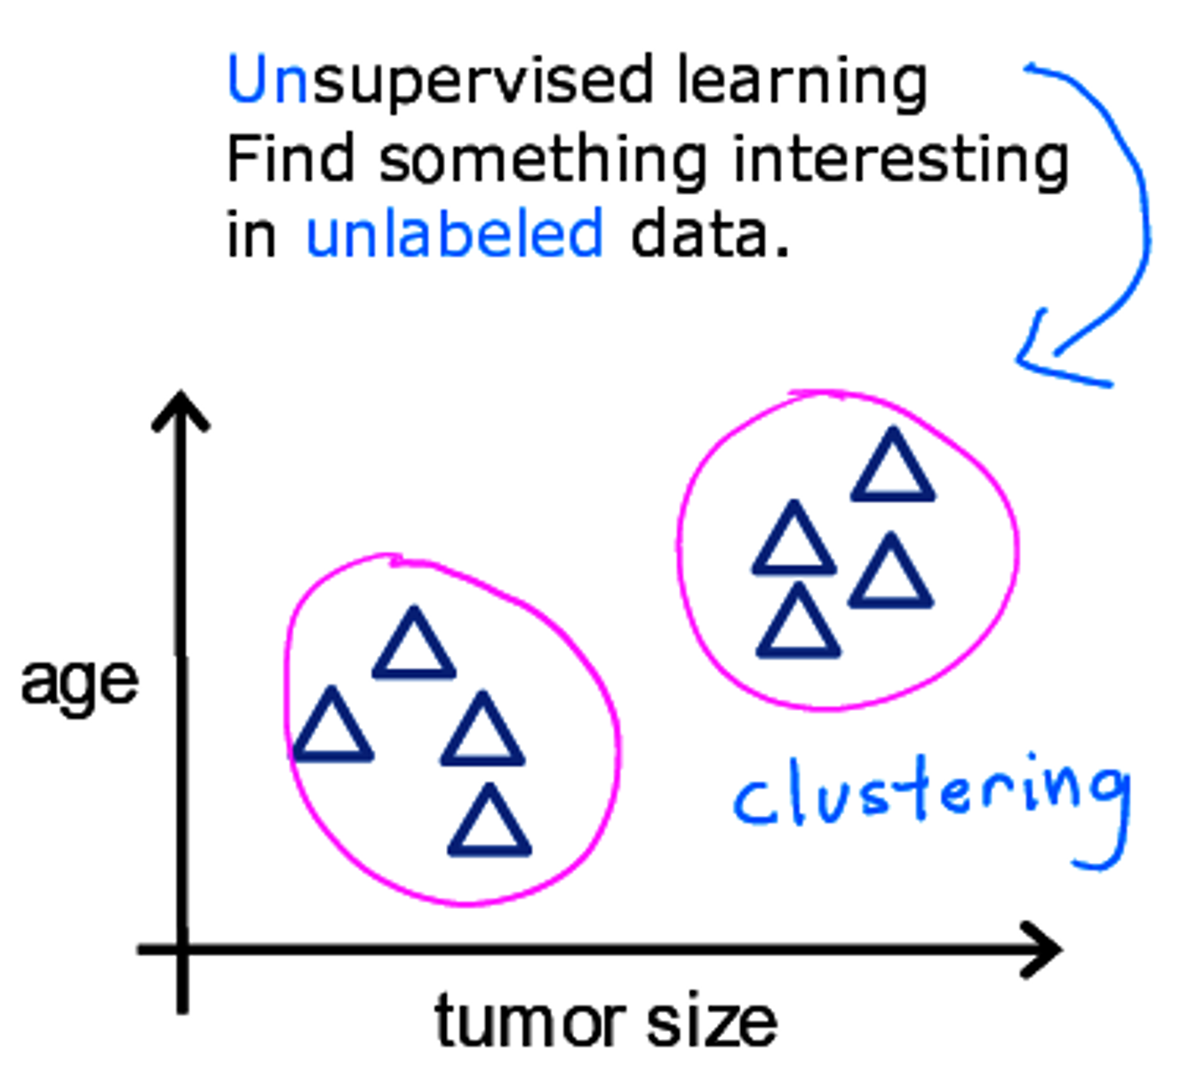
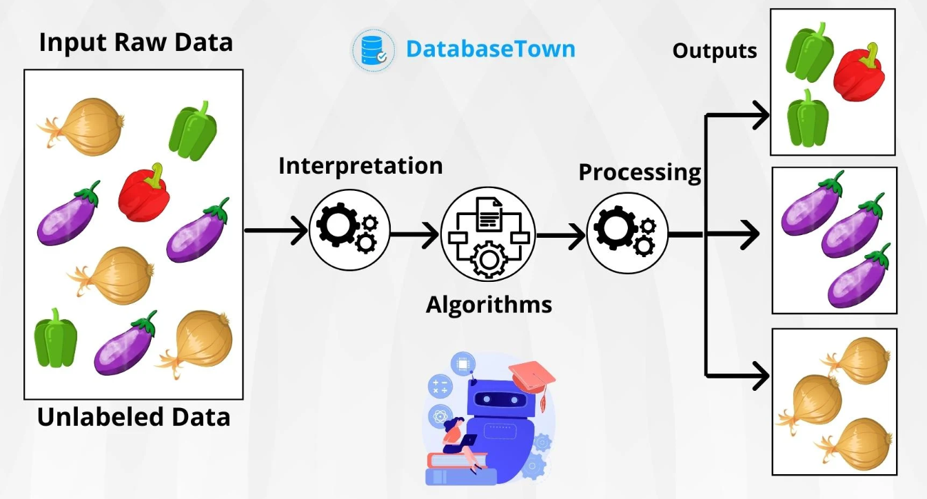
Unsupervised learning

Slide 9
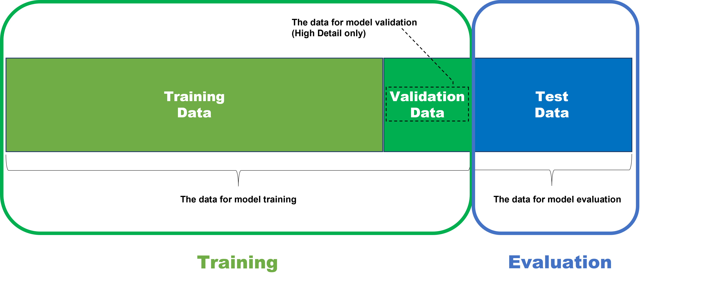
Training – Test set

Slide 10
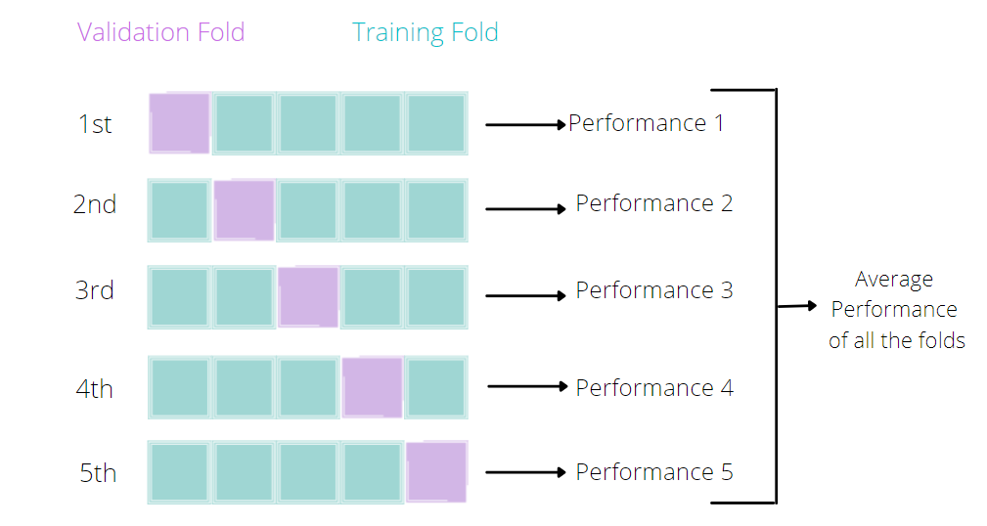
Cross-validation

Slide 11
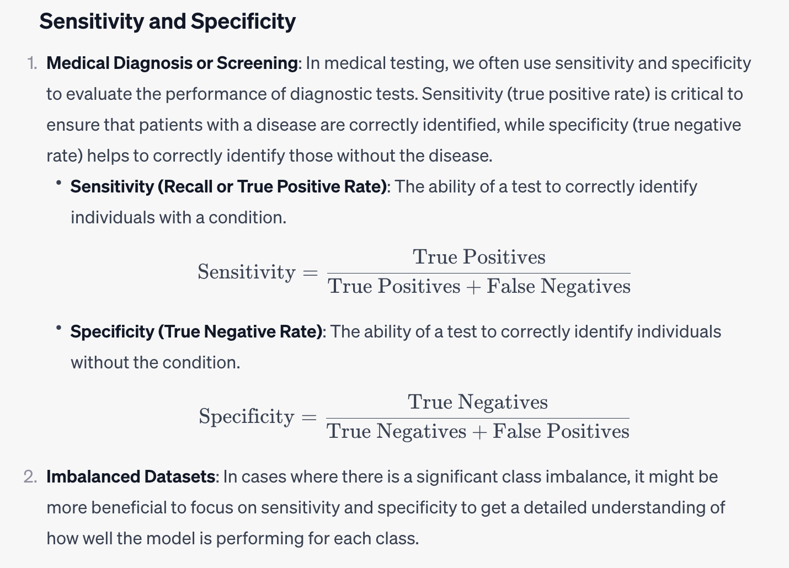
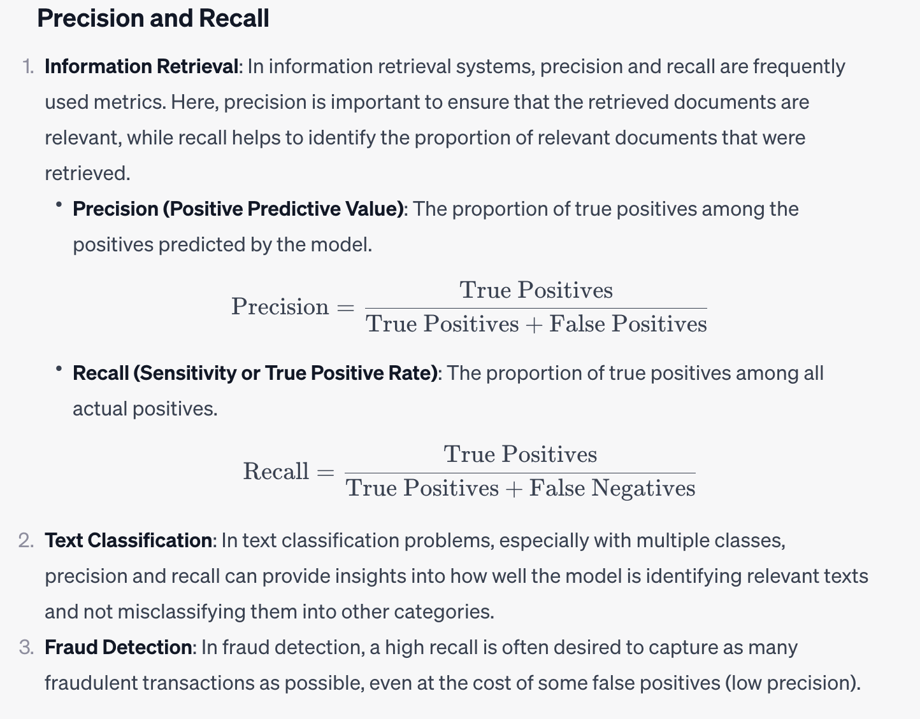
Model Performance Evaluation

Slide 12
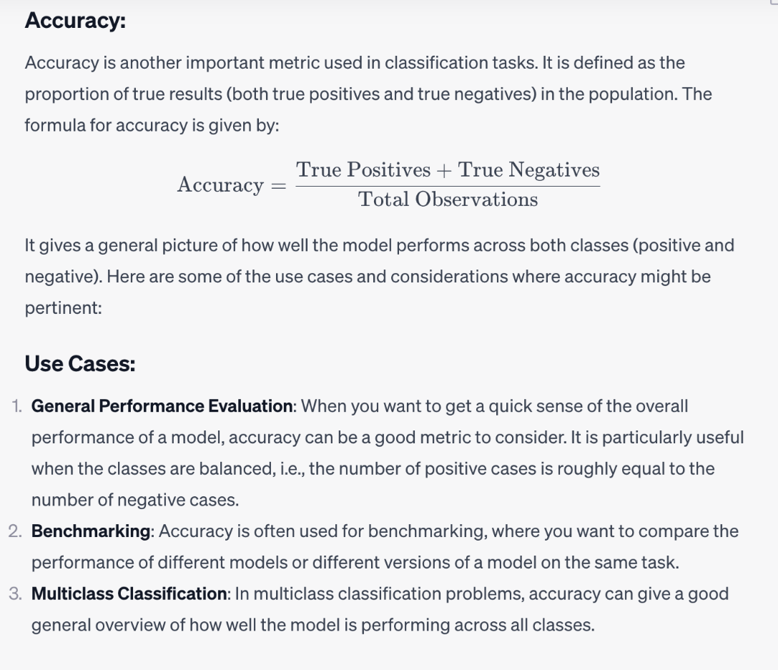
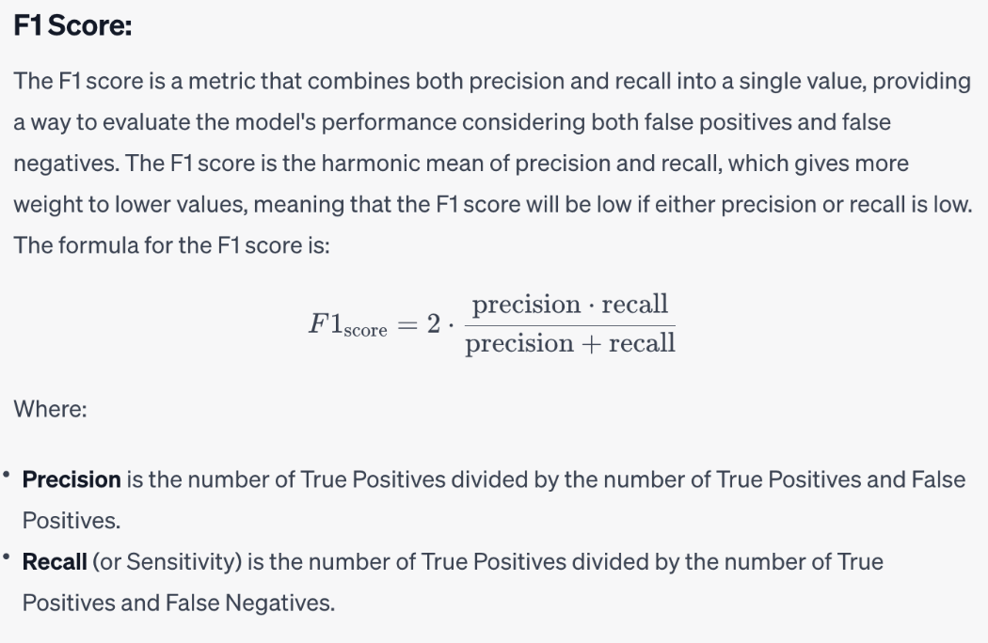
Model Performance Evaluation

Slide 13
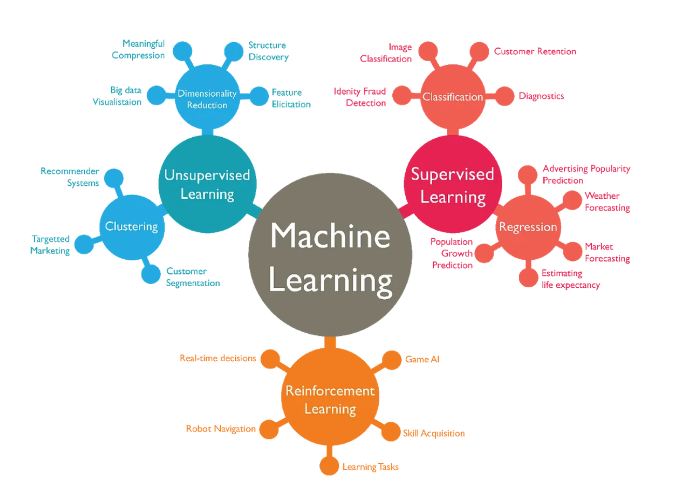
Summary

Slide 14

Low-code platform
Data
Data cleaning
Data ingestion
Data analytics & transformation
Data validation
Feature engineering
Data partitioning
Data Processing
Model building
Model training & tuning
Model validation
Training at scale
Generative AI
Modelling
Model
Data
Deployment
Serving
Monitoring, Logging and Explainability
Finetuning & improvements
Rollout
Model

Slide 15
Components
data_processing_file.xlsx
Project description
Global settings
Data upload
Data cleaning
model_hyperparameters.xlsx
Default hyperparameters
prediction_template.xlsx
Prepopulated predictor values for prediction
Feature engineering
Model list and various parameters

Slide 16
Key outputs
draft_report.pdf
Generative AI drive prepopulated report based on the results
outputs_*
Contains all files containing various modelling outputs and prediction

Slide 17
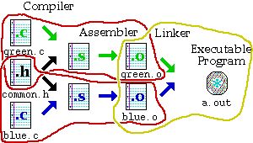
Makefiles
Provide a way for separate compilation.
Describe the dependencies among the project files.
The make utility.

Slide 18
Using Makefiles
Naming:
makefile or Makefile are standard
other name can be also used
Running make
make
make –f filename – if the name of your file is not “makefile” or “Makefile”
make target_name – if you want to make a target that is not the first one

Slide 19
Sample Makefile
Makefiles main element is called a rule:
Example:
my_prog : eval.o main.o
g++ -o my_prog eval.o main.o
eval.o : eval.c eval.h
g++ -c eval.c
main.o : main.c eval.h
g++ -c main.c
_________________________
# -o to specify executable file name
# -c to compile only (no linking)
target : dependencies
TAB commands #shell commands

